Slide 1
Climate Change in the United States
Team 10
Member: Fan Wang, Pengkun Li, Aman Goyal
GitHub: https://github.com/WFighter909/ECE-143-Group-10

Slide 2
CONTENTS
Introduction
Data Collection and Preprocess
Comparison between West and East Coast
Data Visualization of San Diego
Evaluations and Applications

Slide 3
Introduction
/01

Slide 4
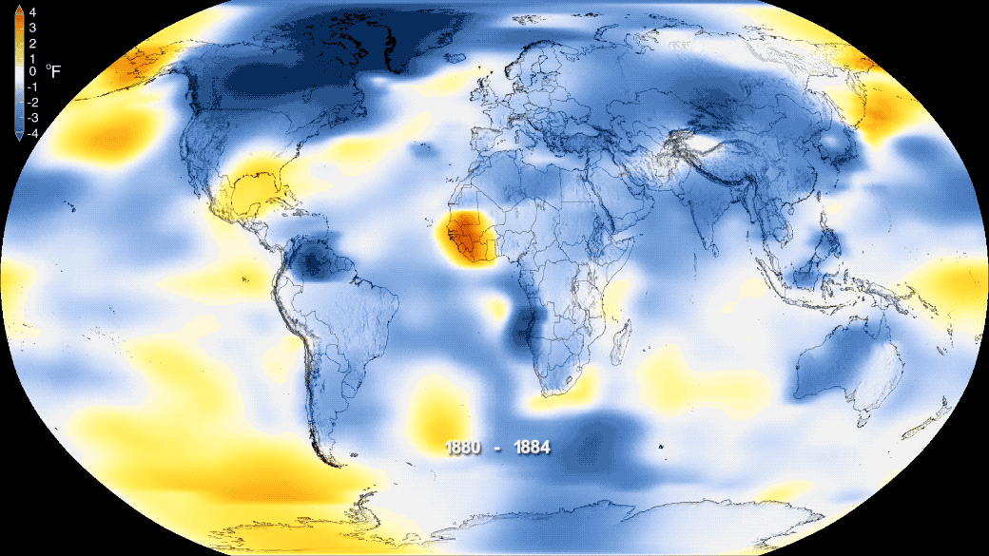
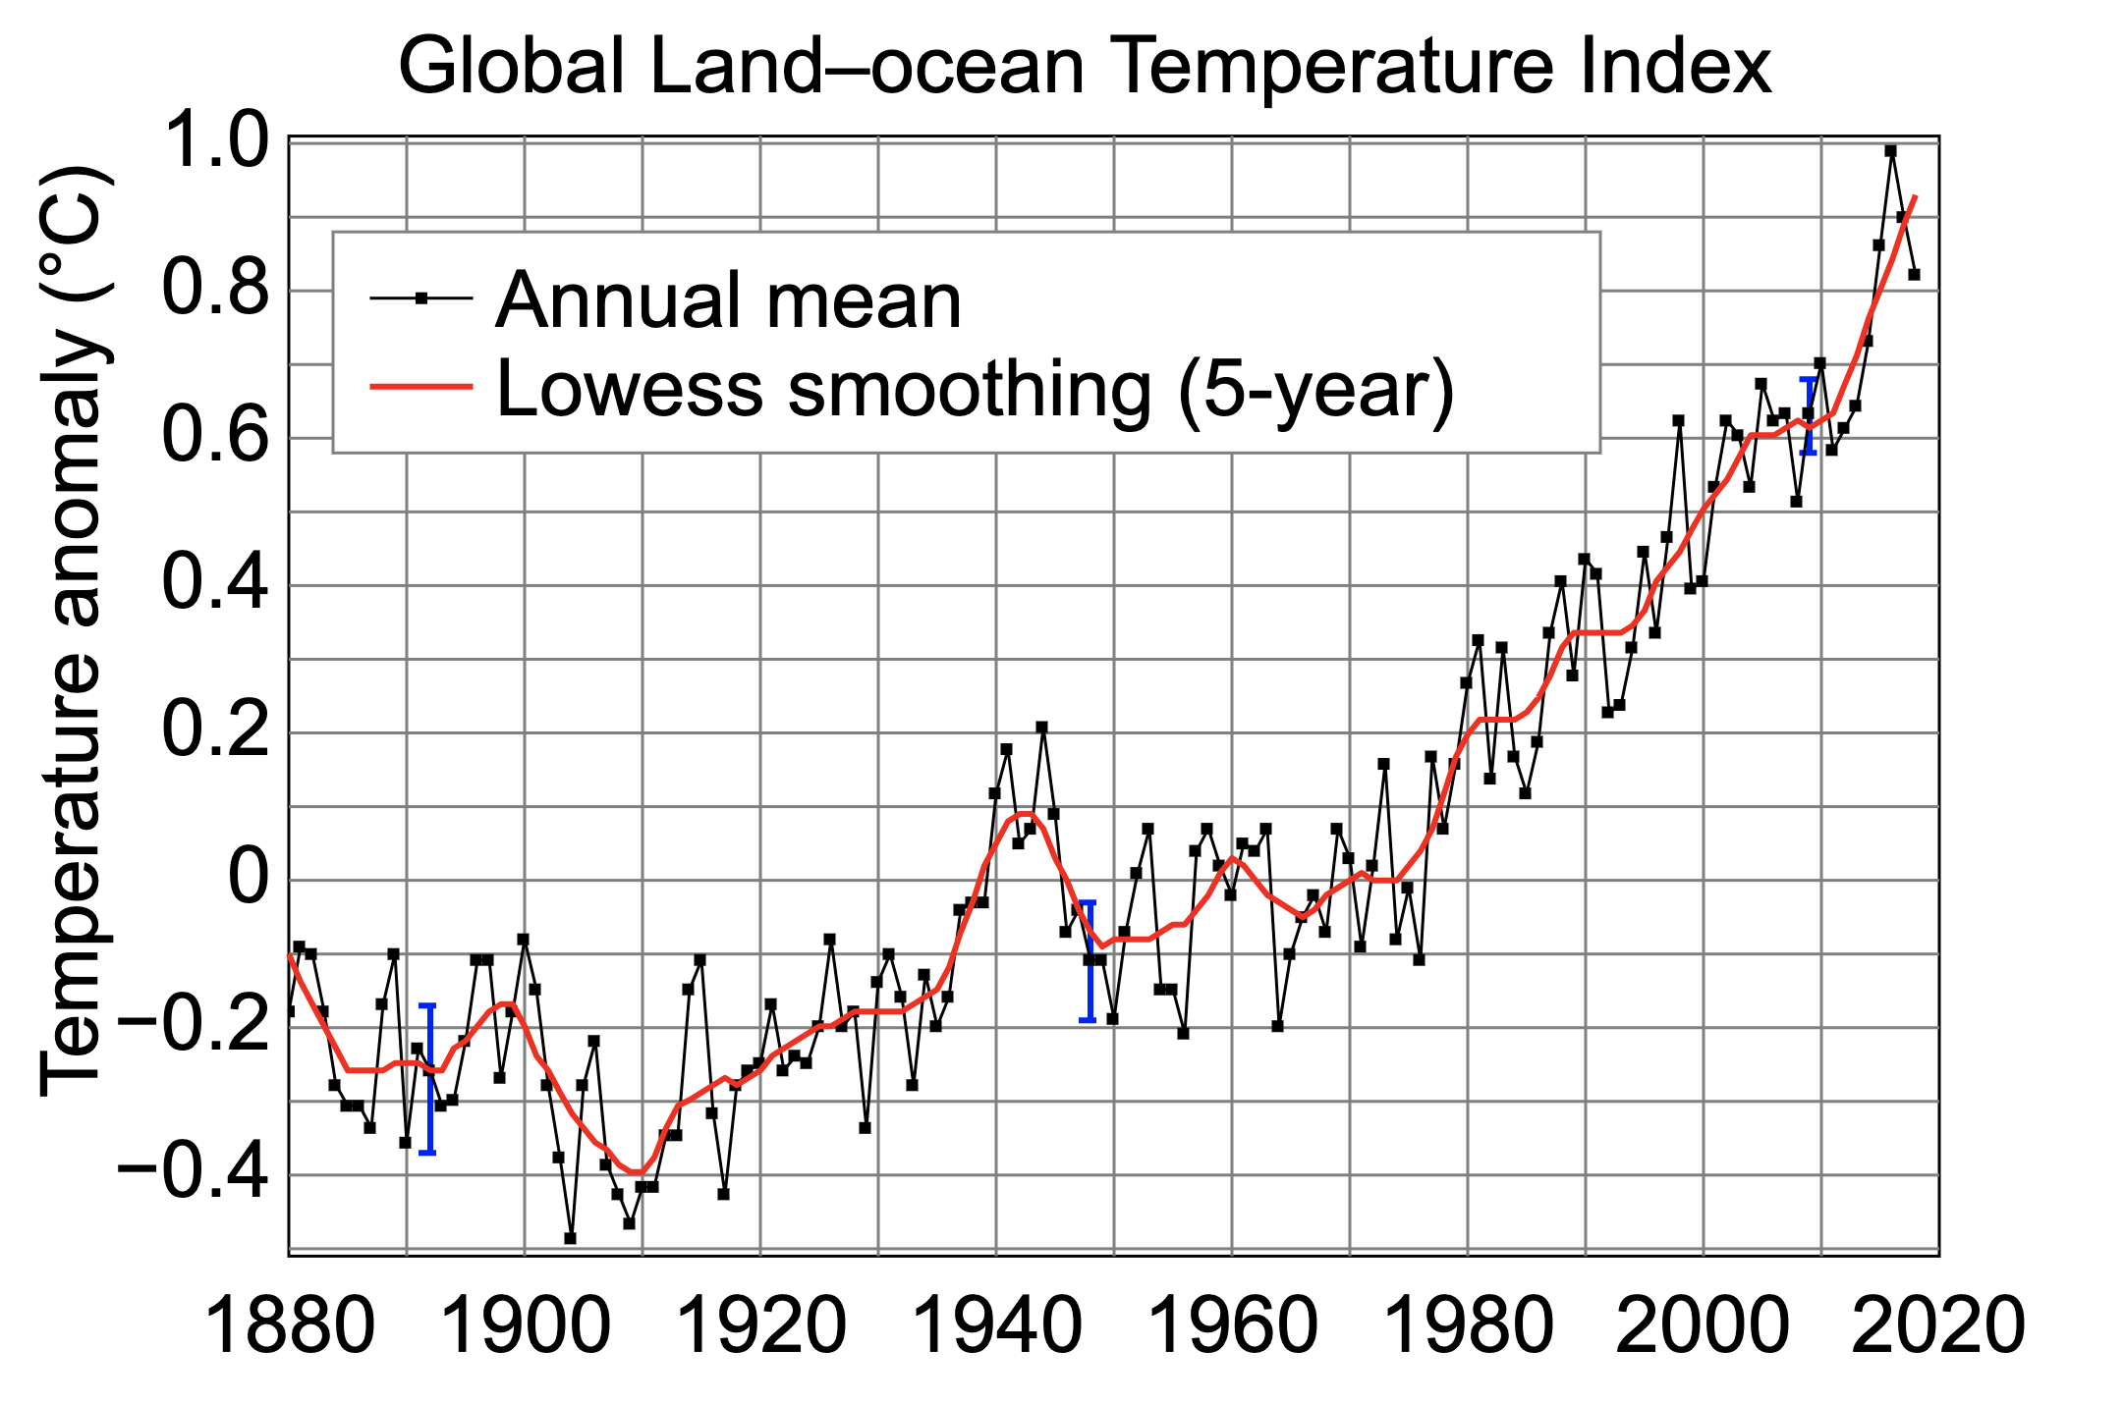
Climate Change in Recent Years
The Phenomenon of Climate Change:
global warming
forest degradation
desertification
https://climate.nasa.gov/news/2876/new-studies-increase-confidence-in-nasas-measure-of-earths-temperature/

Slide 5
Proposals & Goals
To explore the trends of climate change in some cities in the United States by visualizing weather data over the past few decades.
To remind everyone of the importance of environmental issues brought about by climate change.

Slide 6
Data Collection and Preprocess
/02

Slide 7
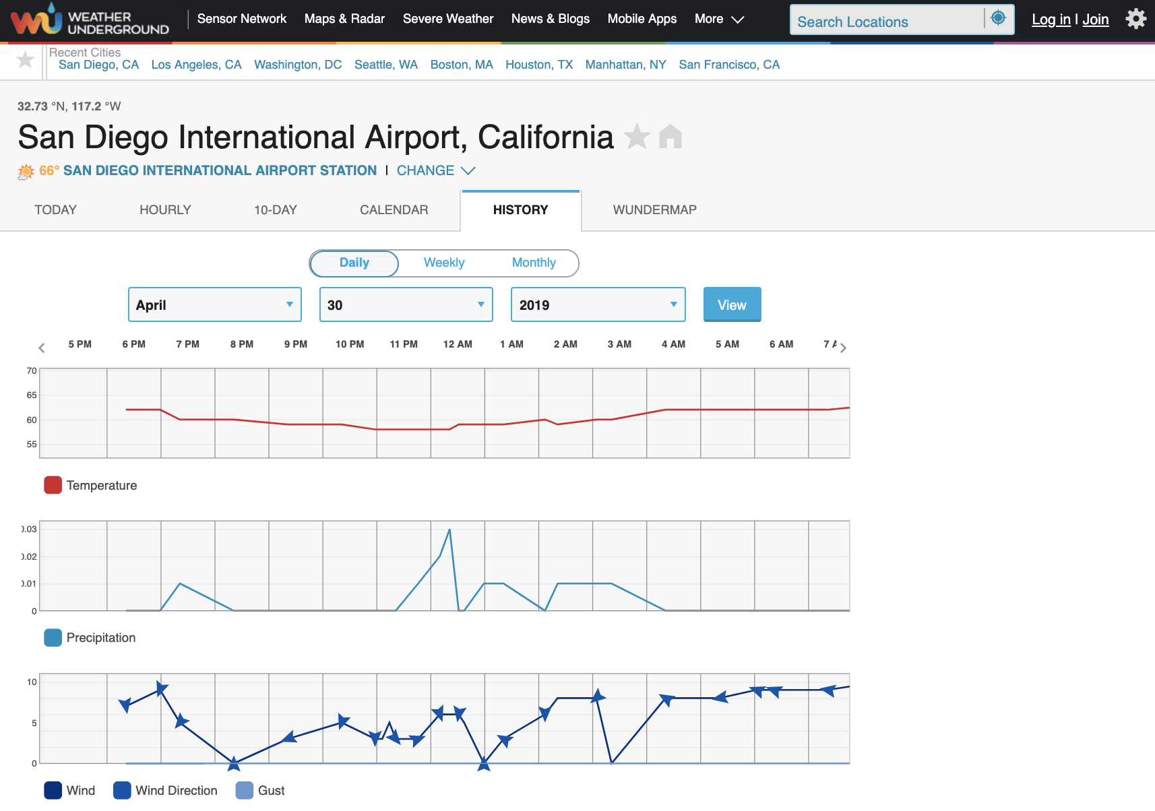
Weather Underground
link
A sensor network of weather information
Notes:
link

Slide 8
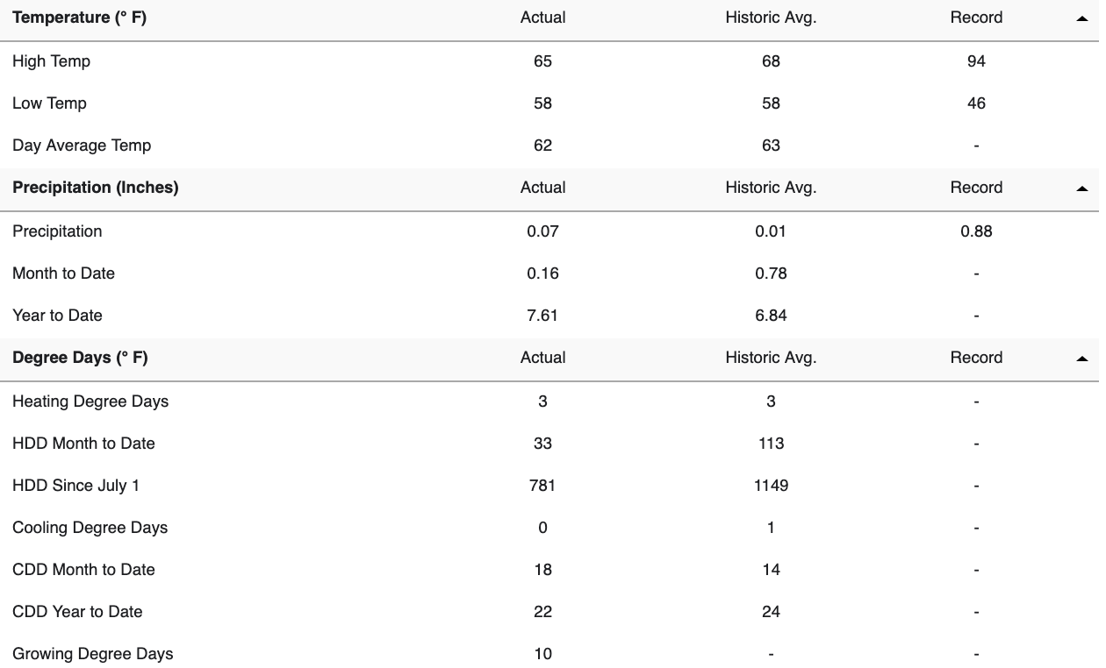
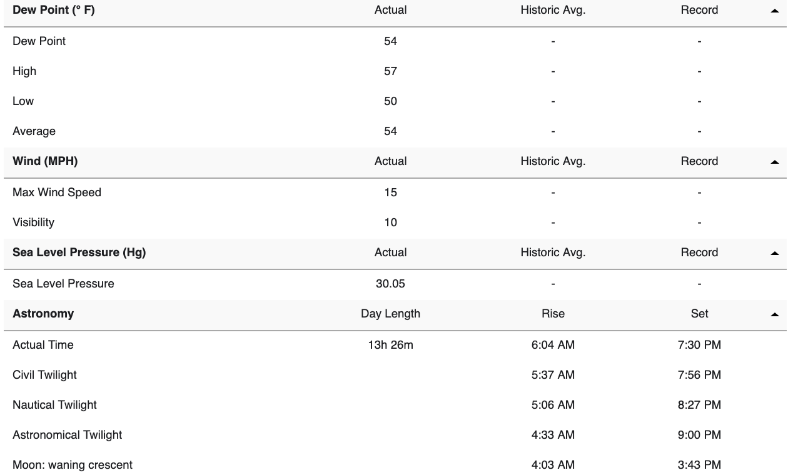
Data Summary

Slide 9
Data Selected
weather icon

Slide 10
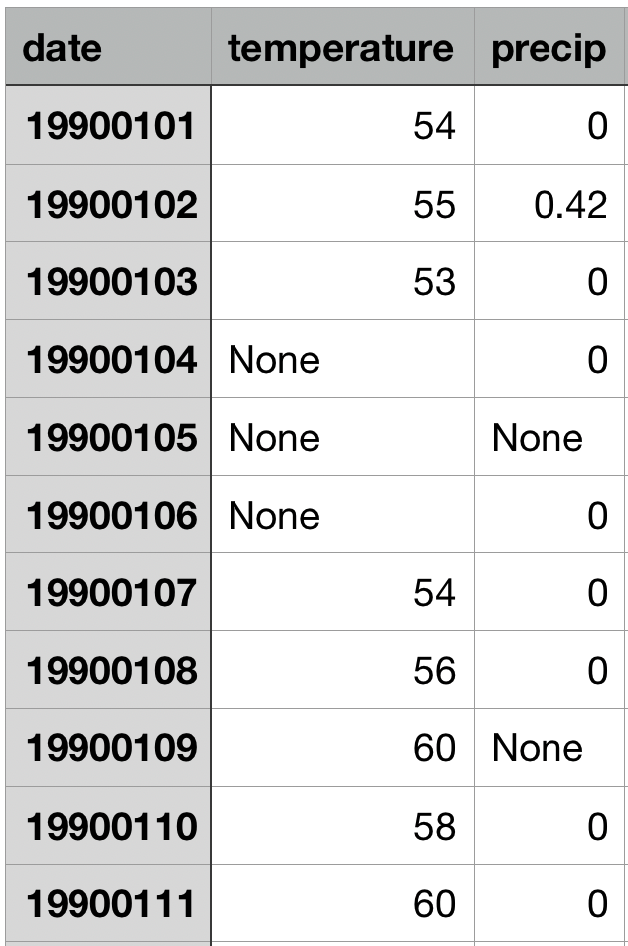
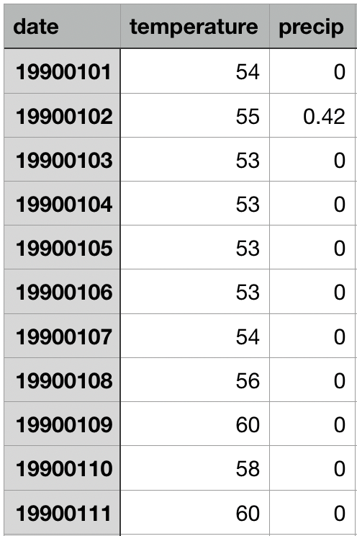
Data Cleaning and Missing Data Filling
missing_values = ["n/a", "na", "--", None, 'None']
use forward-fill to fill the missing values:
pandas.DataFrame.fillna(method="ffill", inplace=True)
Notes:
for some cells where the data was not available, we used the forward fill method from pandas to compensate for the missing data

Slide 11
Comparison between West and East Coast
/03

Slide 12
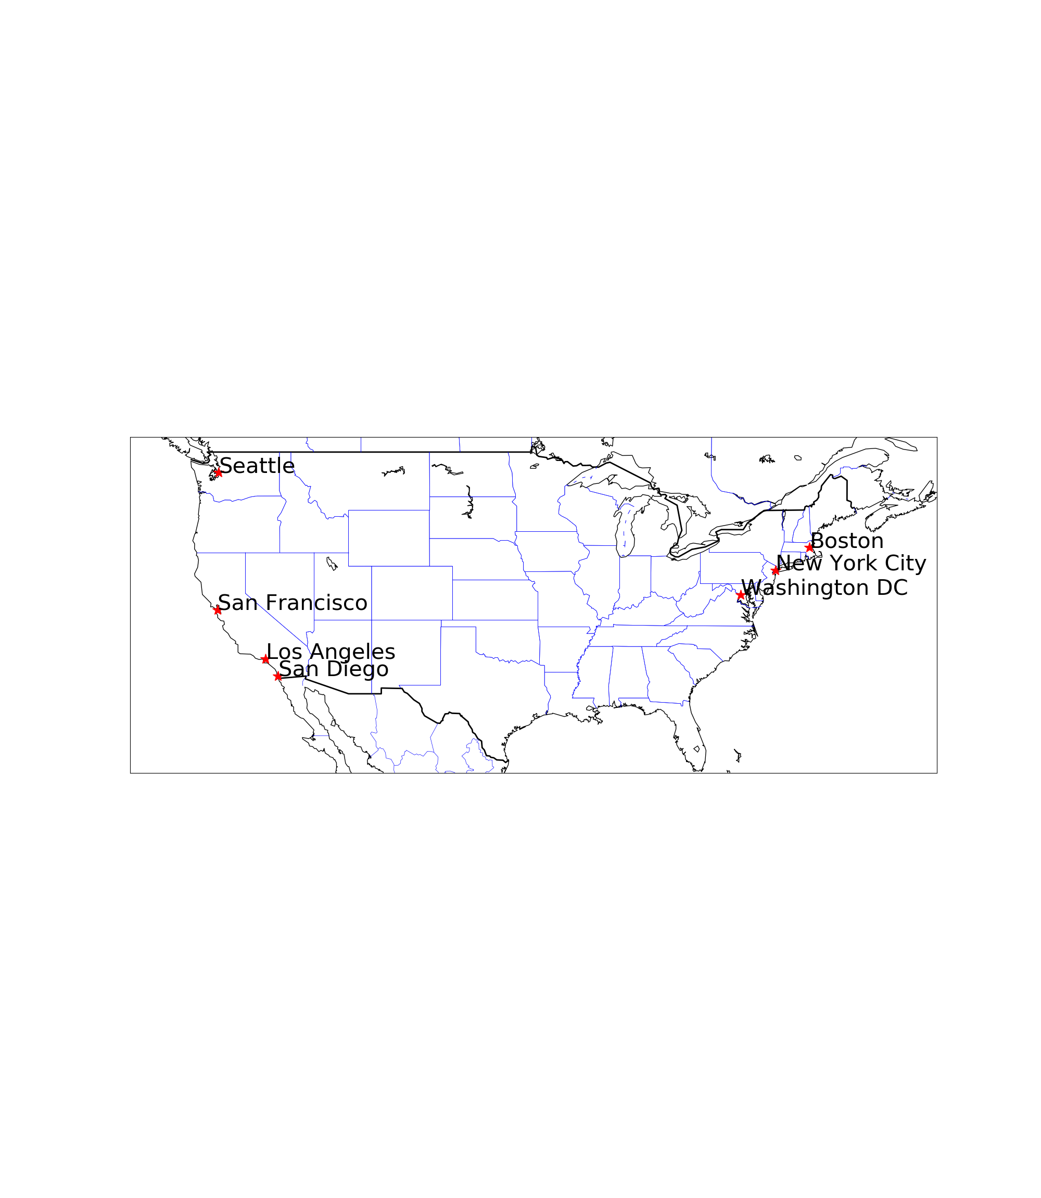
The Distribution of Selected Cities
city code reference

Slide 13
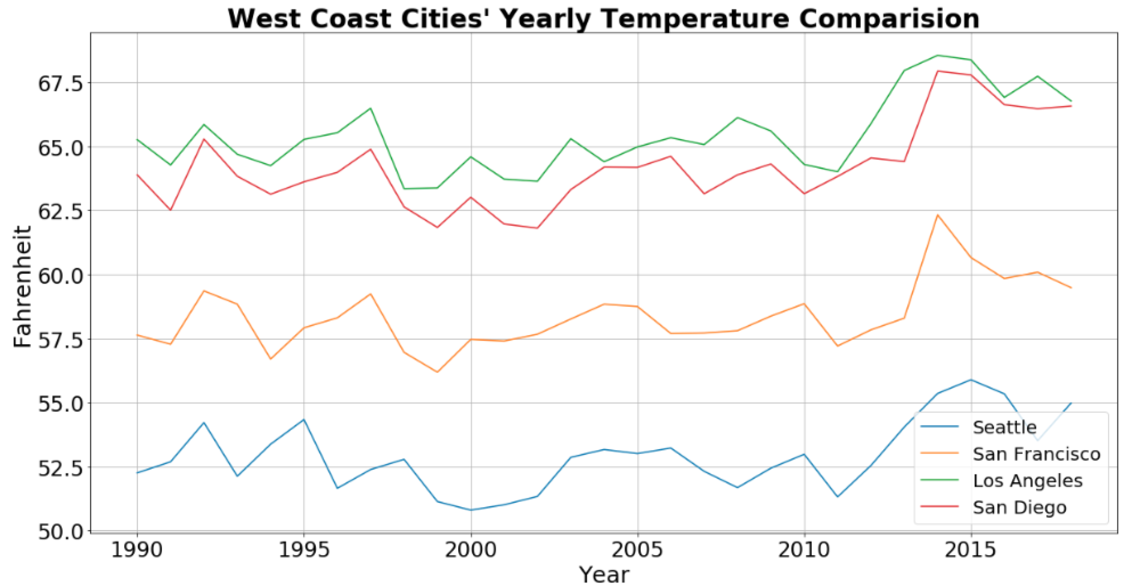
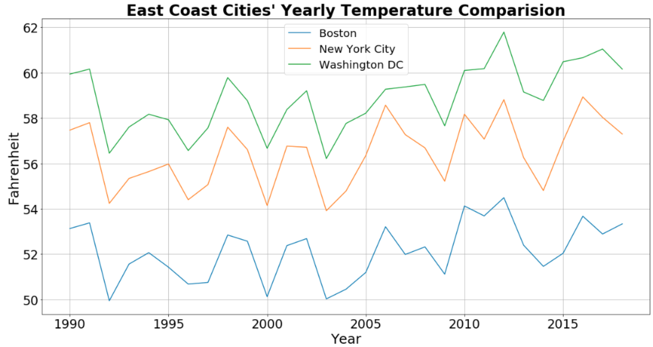
Average Temperature Comparison -- Year wise
Notes:
As we move from South to North (top to bottom in the graph), we see an expected decrease in temperature.
Also, we can observe a correlated weather transition over the years for the cities which grouped by east or west coast.
Cities in the same latitude on the east and west coasts (ie. Boston and Seattle) have roughly the same range of temperature fluctuations.
Temperatures in all cities show an overall slightly upward trend.

Slide 14
Average Temperature Correlation
Notes:
The difference of the east coast city precipitation between the north and south latitude is small
The east coast has more precipitation than the west coast, and in 1995 there was a collective peak.

Slide 15
Summary
Cities in the same latitude on the east and west coasts (ie. Boston and Seattle) have roughly the same range of temperature fluctuations.
As we move North, the average temperature decreases
Temperatures in all cities show an overall slightly upward trend.

Slide 16
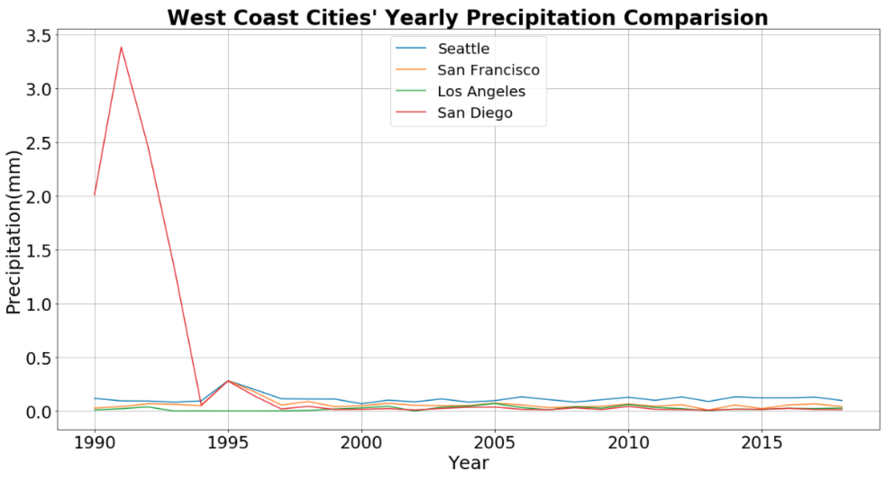
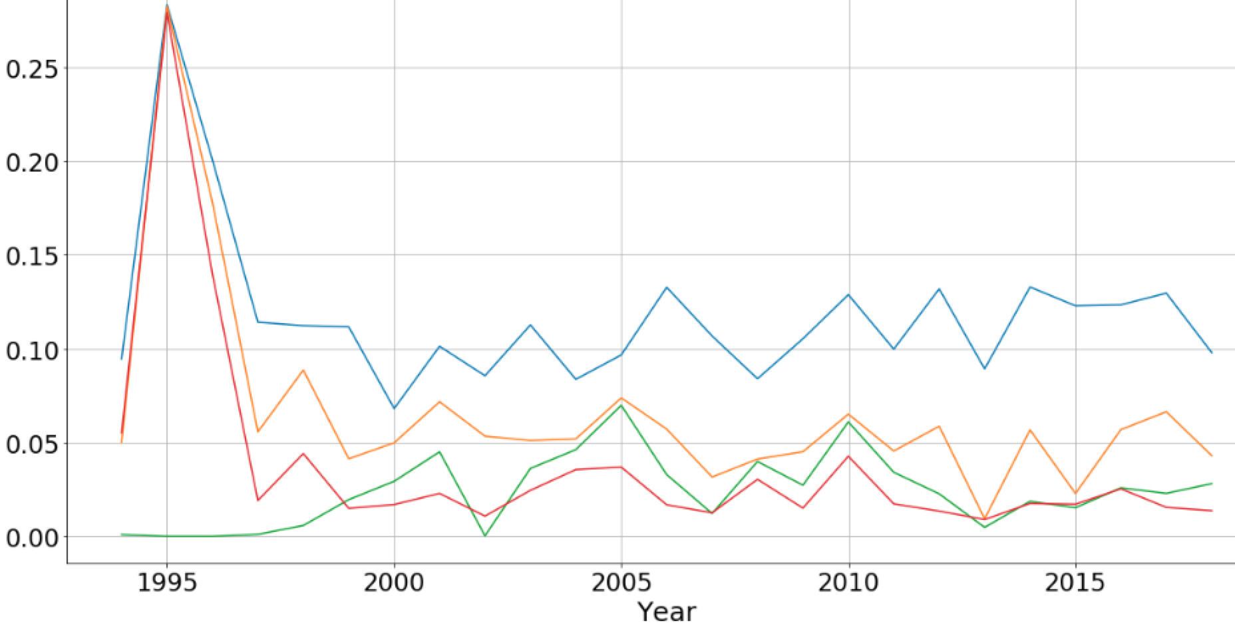
Average Precipitation Comparison -- Year wise (West Coast)
Notes:
The difference of the wast coast city precipitation between the north and south latitude is small
Urban precipitation on the West Coast is relatively small and stable, except for San Diego’s data in 1991. This cause us to inspect SD in detail

Slide 17
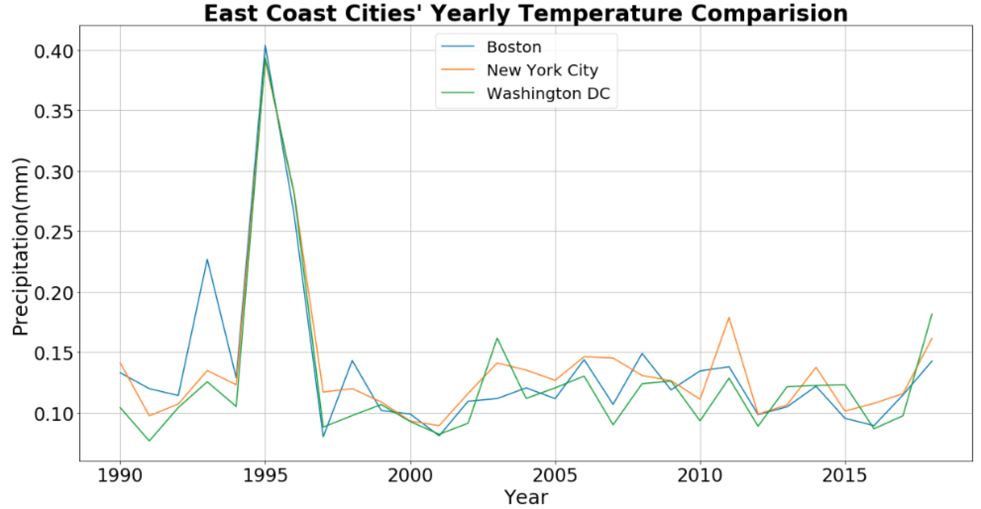
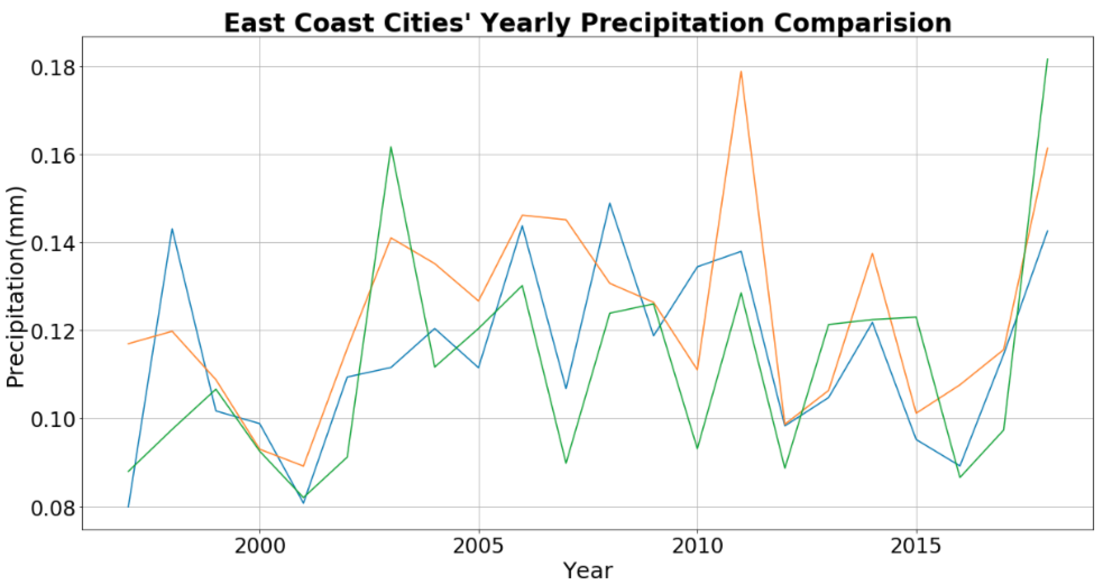
Average Precipitation Comparison -- Year wise (East Coast)
Notes:
The difference of the east coast city precipitation between the north and south latitude is small
The east coast has more precipitation than the west coast, and in 1995 there was a collective peak.

Slide 18
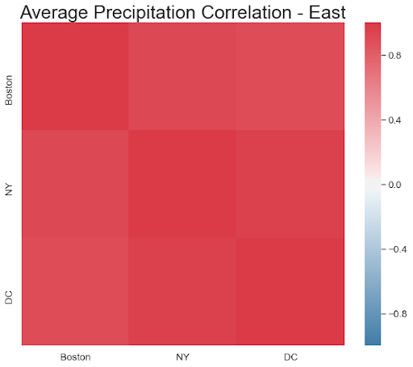
Average Precipitation Correlation
Notes:
The difference of the east coast city precipitation between the north and south latitude is small
The east coast has more precipitation than the west coast, and in 1995 there was a collective peak.

Slide 19
Summary
Urban precipitation on the West Coast is relatively small and stable, except for San Diego’s data in 1991.
East coastal cities have more precipitation than west coastal cities. But latitude changes have little effect on changes in precipitation.

Slide 20
Data Visualization for San Diego
/04

Slide 21
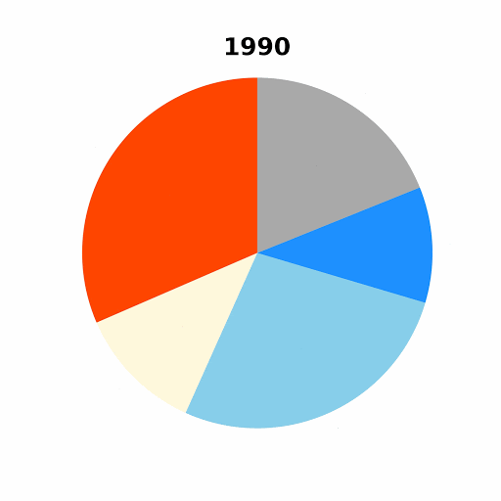
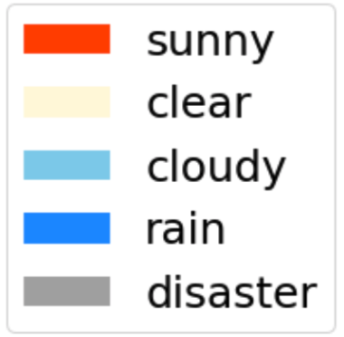
Weather of San Diego (1990 - 2018)
The proportion of rainy days in San Diego is basically the same.
San Diego experienced severe disaster weather around 1995, but it has improved through the years.
Notes:
The disaster weather condition includes hazy and stormy weather conditions.
For approximately half of the days, San Diego has either sunny or clear sky.

Slide 22
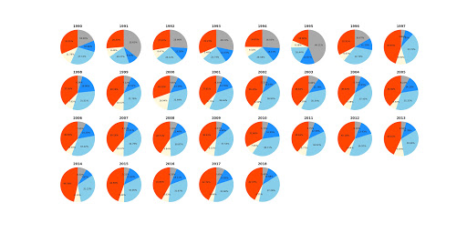
Weather of San Diego (1990 - 2018)
Notes:
The disaster weather condition includes hazy and stormy weather conditions.
For approximately half of the days, San Diego has either sunny or clear sky.

Slide 23

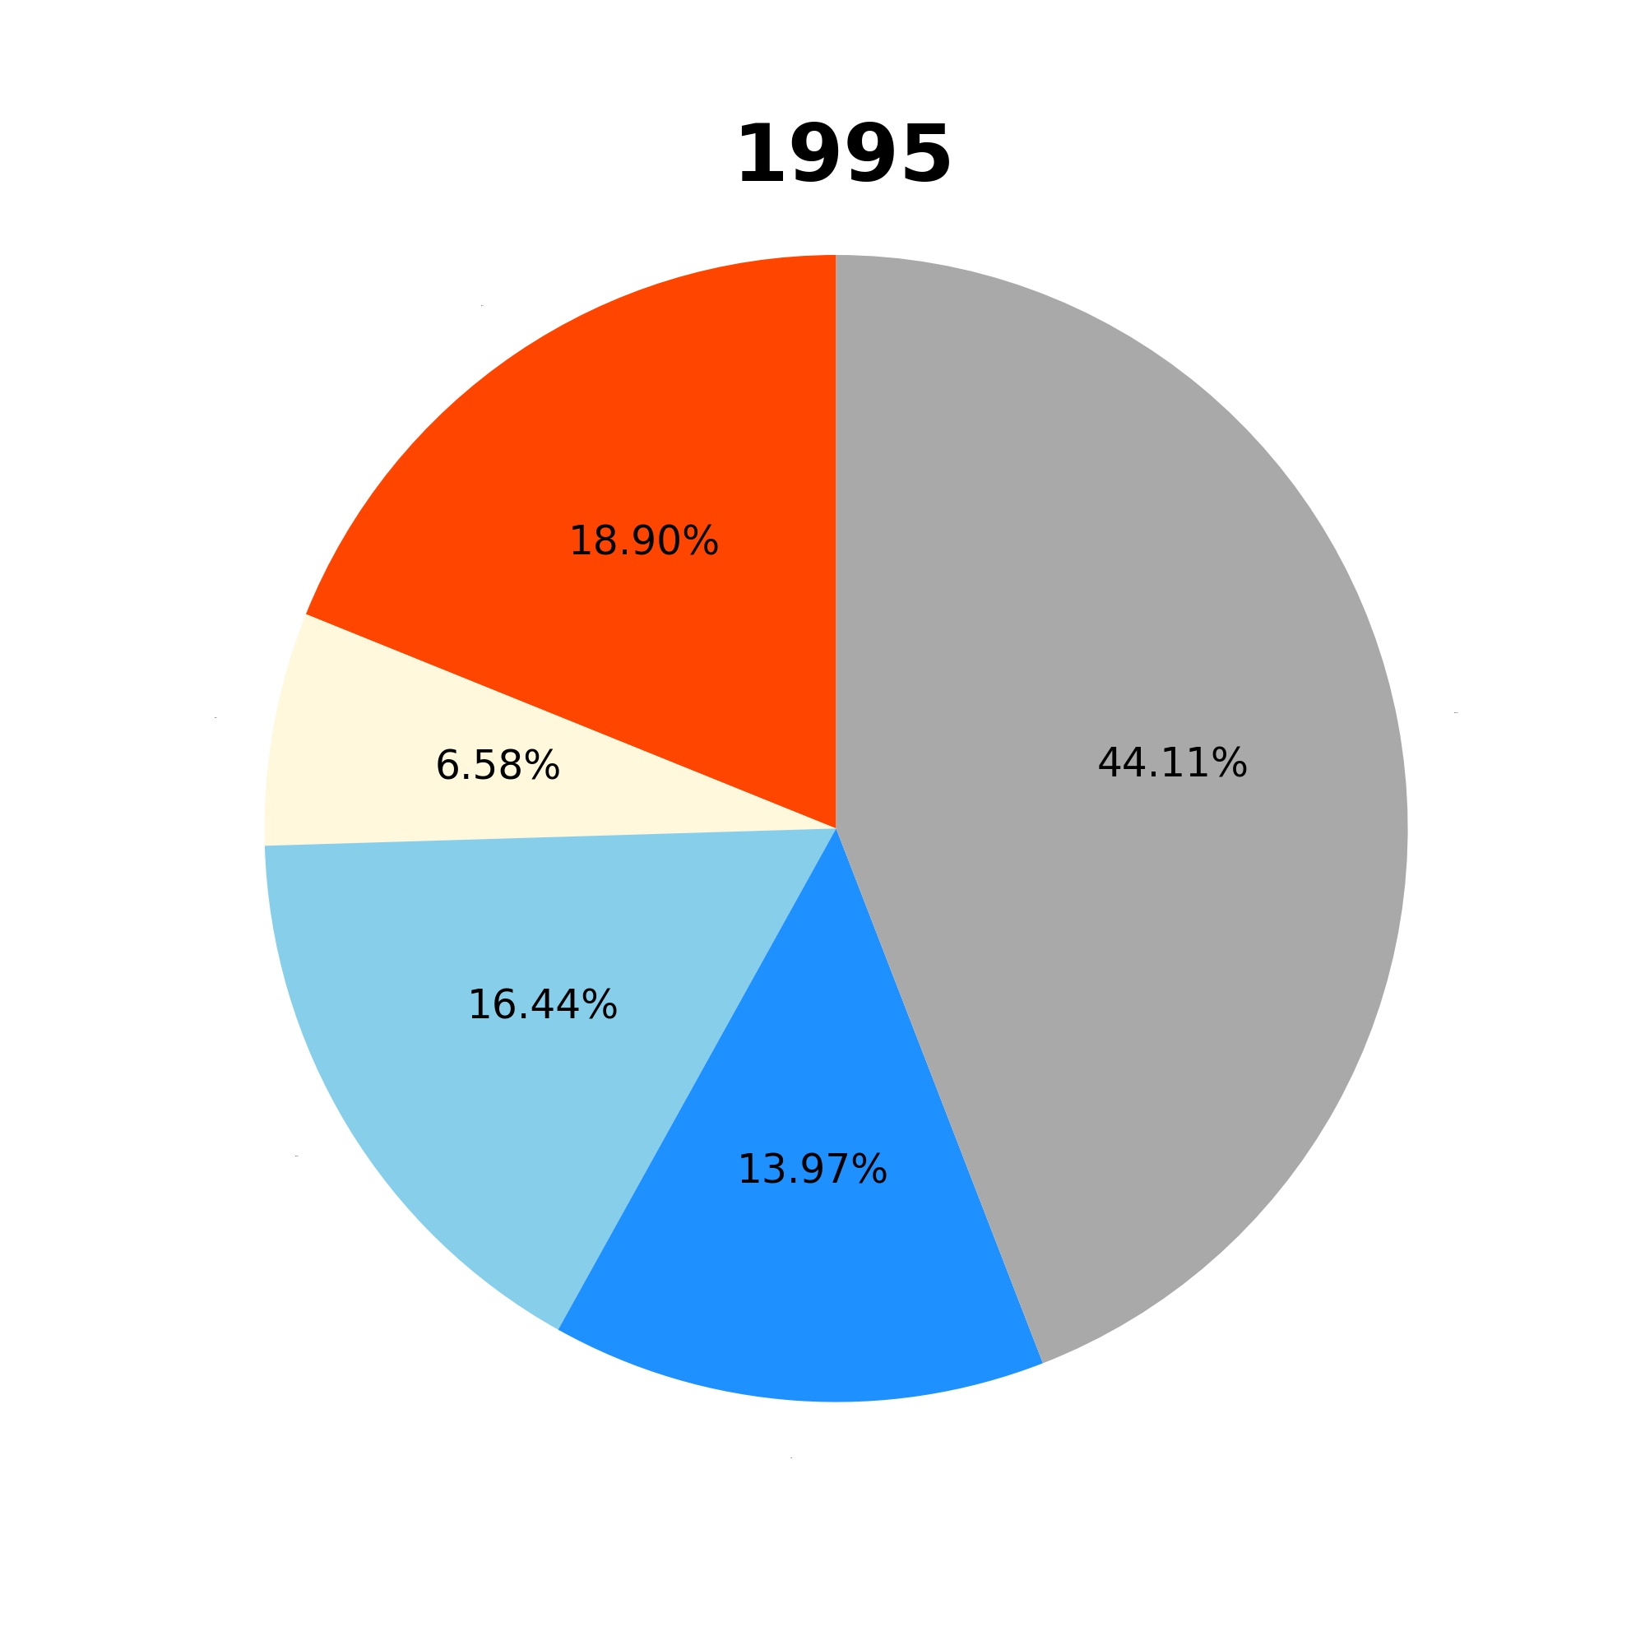
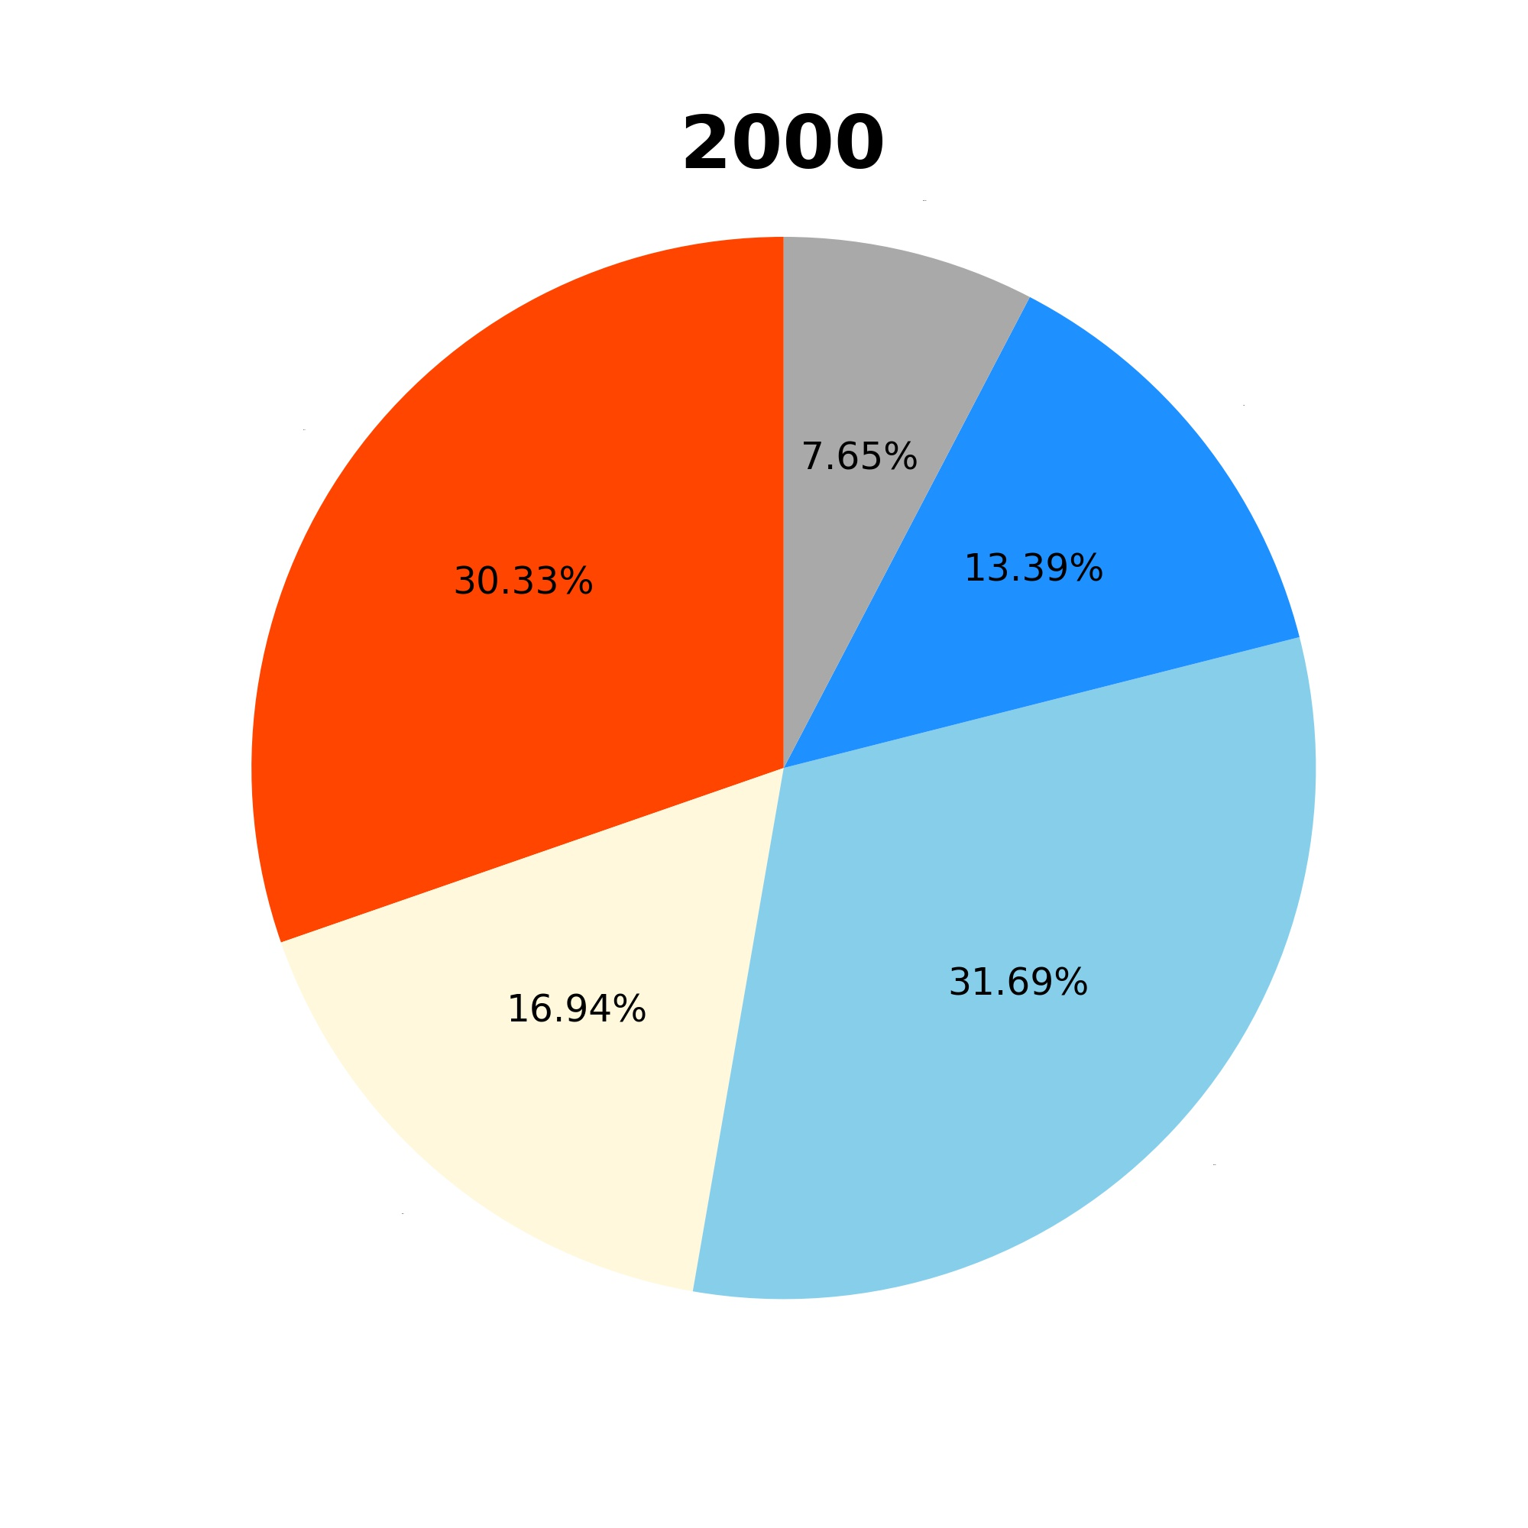
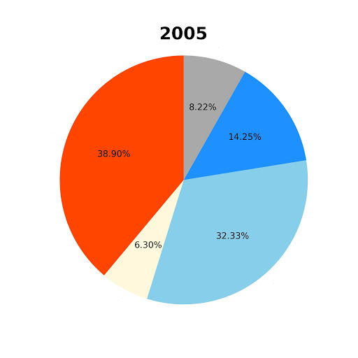
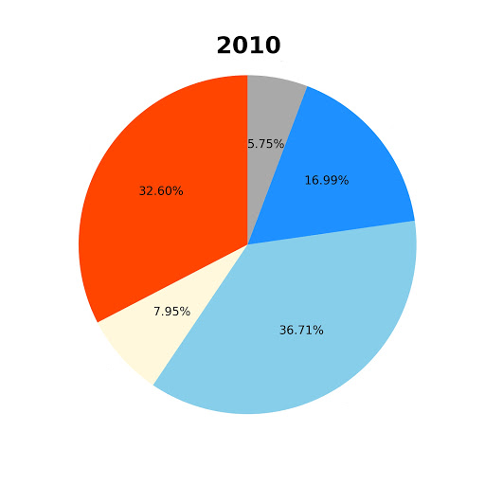
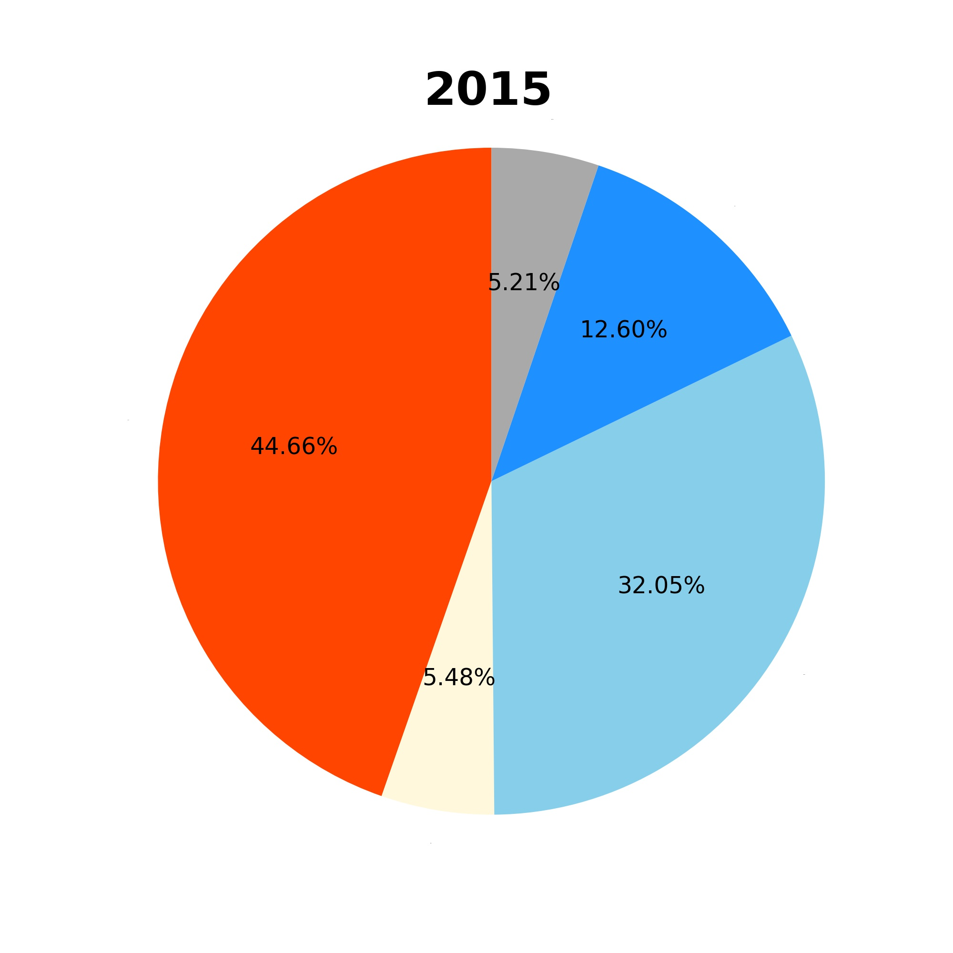
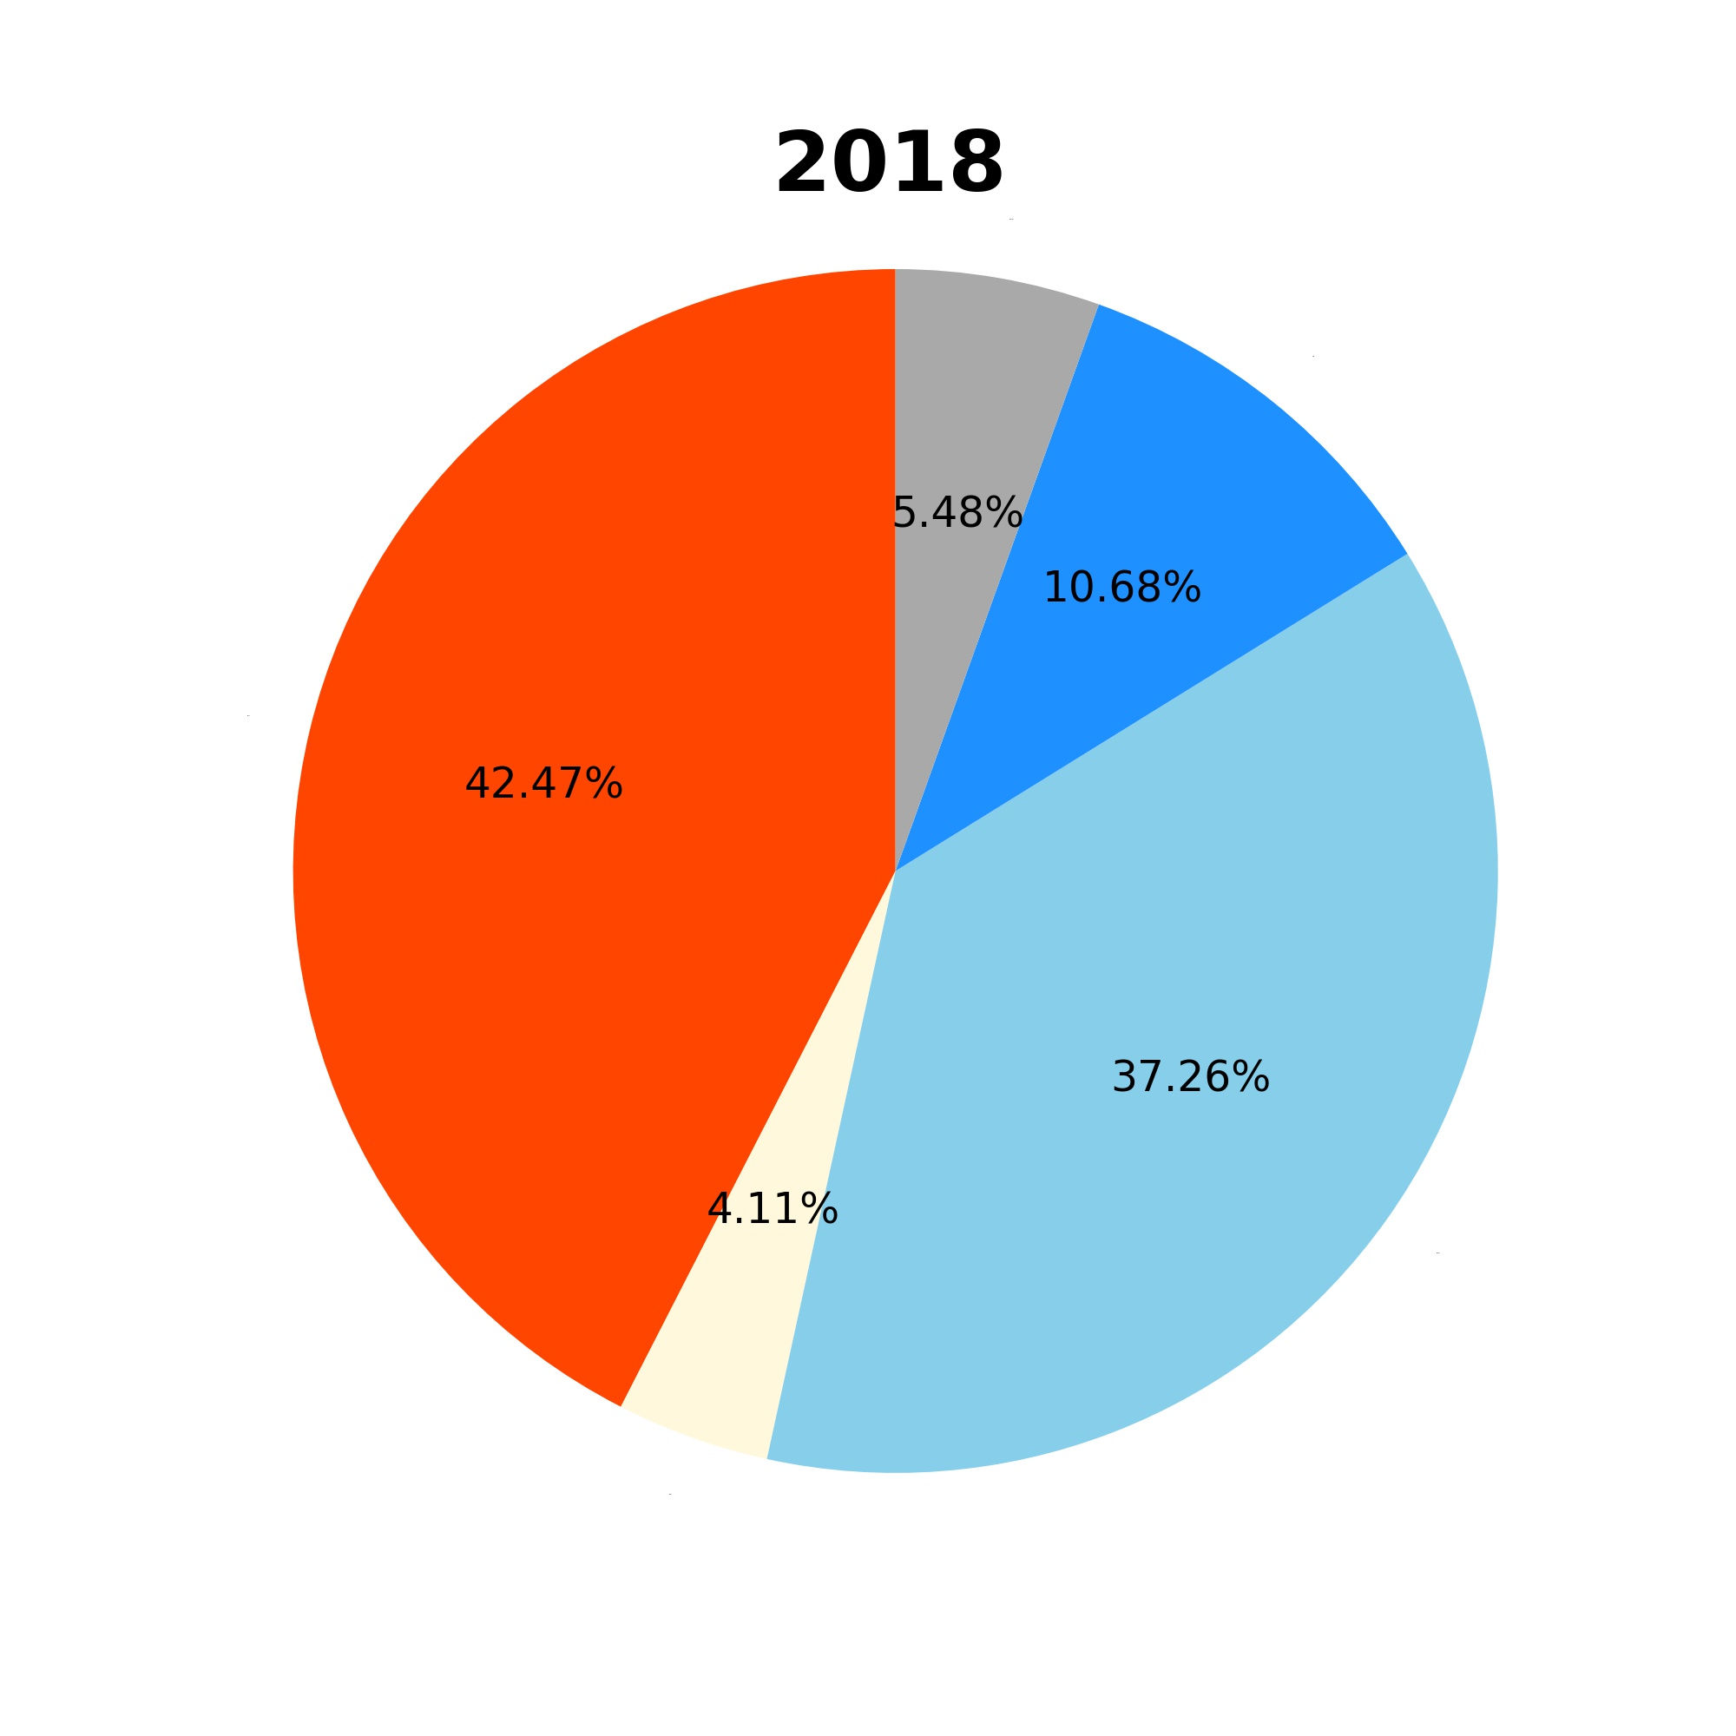
Weather of San Diego (1990 - 2018)
Notes:
The disaster weather condition includes hazy and stormy weather conditions.
For approximately half of the days, San Diego has either sunny or clear sky.

Slide 24
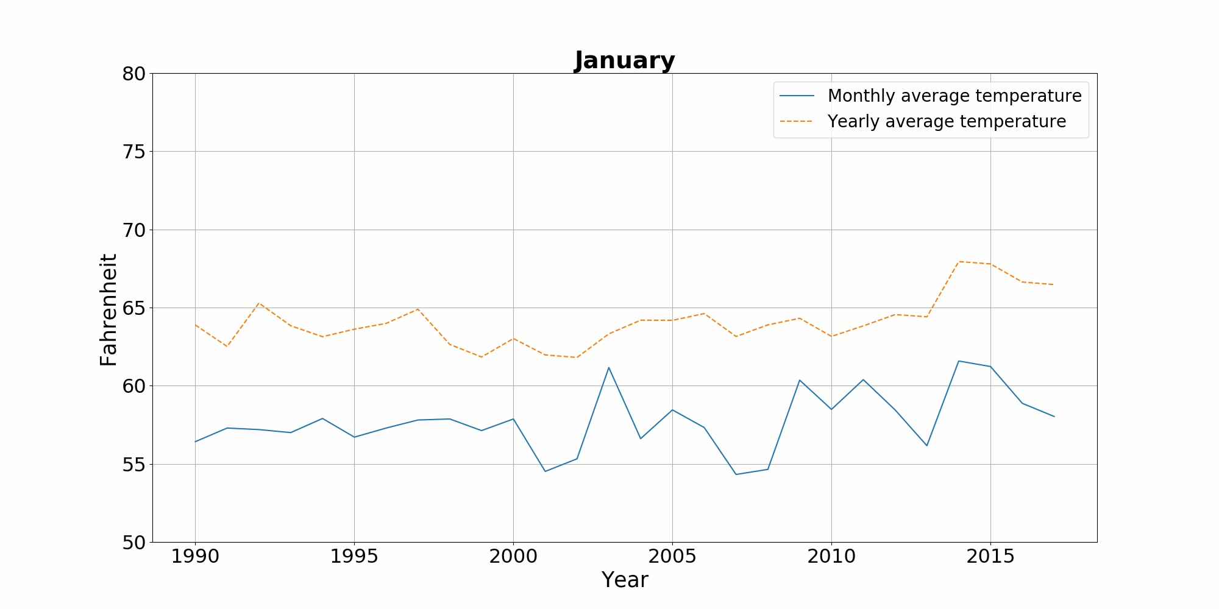
Average Temperature of San Diego (1990 - 2018)

Slide 25
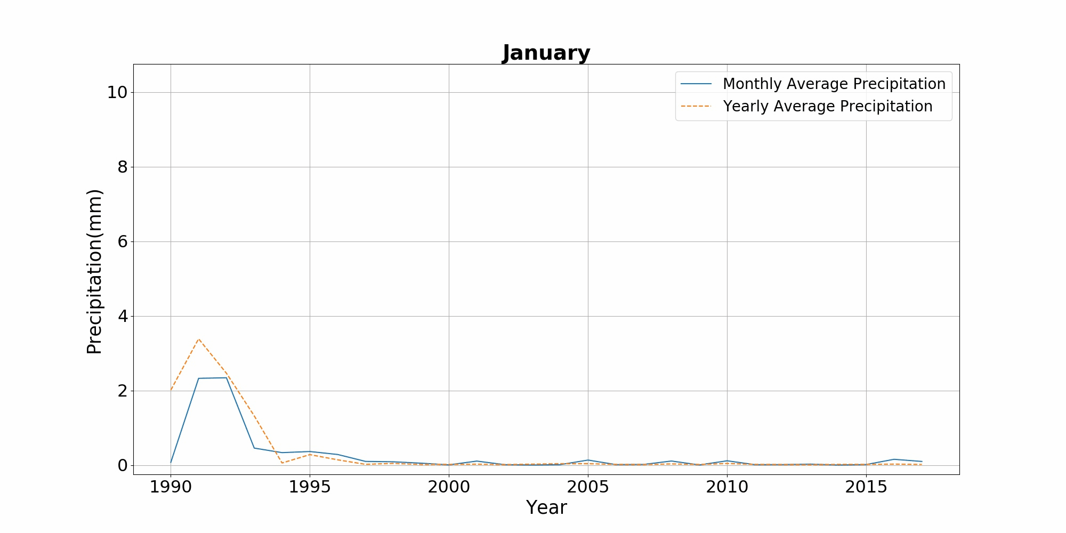
Average Precipitation in San Diego (1990 - 2018)
Notes:
The overall precipitation in San Diego is relatively small, mostly in the autumn and winter seasons.

Slide 26
Summary
The average temperature per month in San Diego has fluctuated over the years but has shown a slight upward trend overall.
The overall precipitation in San Diego is relatively small, mostly in the autumn and winter seasons.
Overall, San Diego is a city with moderate temperatures, mostly sunny days and less precipitation. But still receiving the impact of global climate change, the temperature has risen.

Slide 27
Evaluations and Applications
/05

Slide 28
Evaluations and Applications
Demo
Since we don’t have an access to the comprehensive weather data for a longer duration of time, we are not able to make any comment on climate change in general.
After evaluation, this project can be used to get an overall picture of the weather conditions of a city, just by plugging in the city code.
Notes:
Show code?

Slide 29
Future Works
Comprehensive Evaluation: Increase the number of cities inspected to find the more general trends and conclusions
Bigger Dataset: Add the data of years before 1990 to study real - climate change
Data Compensation: Optimize the way in which missing data is compensated
Outlier handling: Add processing mechanism for exception data

Slide 30
Thanks!

Slide 31
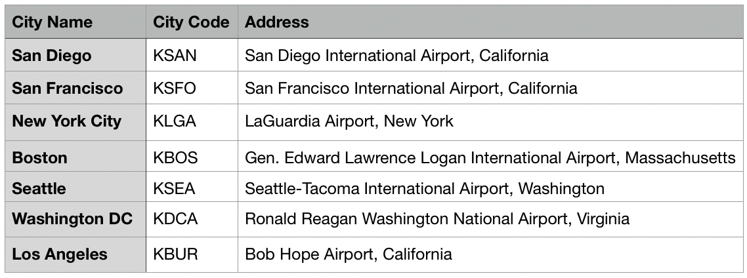
Appendix - City Code Reference
back

